Slide 1

Air Quality Index in Jakarta

Slide 2
ABOUT ME
Sani Supriya
Btech ,Cse
Linked in: https://www.linkedin.com/in/supriya2909/

Slide 3
DATASET OVERVIEW
Dataset contains air quality measurements from 2010 to 2024
Data collected from multiple monitoring stations (stasiun)
Includes major pollutants such as:
PM2.5,PM10,SO2,CO,O3NO2
Also includes:
Date (tanggal),AQI Category (categori)

Slide 4
DESCRIPTION OF COLUMNS
tanggal : The date when the AQI measurement was recorded.
stasiun : The name or identifier of the monitoring station where the measurement was taken.
pm25 : The concentration of particulate matter with a diameter of 2.5 micrometers
pm10 : The concentration of particulate matter with a diameter of 10 micrometers or less (PM10), measured in micrograms per cubic meter (µg/m³).
so2 : The concentration of sulfur dioxide (SO2), measured in parts per million
co : The concentration of carbon monoxide (CO), measured in parts per million
o3 : The concentration of ozone (O3), measured in parts per million
no2 : The concentration of nitrogen dioxide (NO2), measured in parts per million
max : The maximum value recorded among the pollutants for that particular date and station.
critical: The pollutant that had the highest concentration for that date and station.
category : The air quality category based on the 'max' value that describes the air quality level.

Slide 5
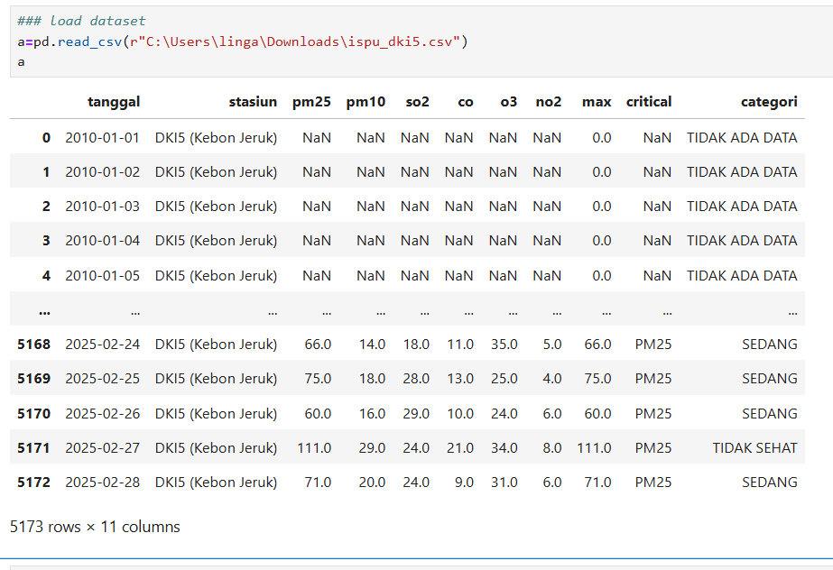
READING DATASET

Slide 6
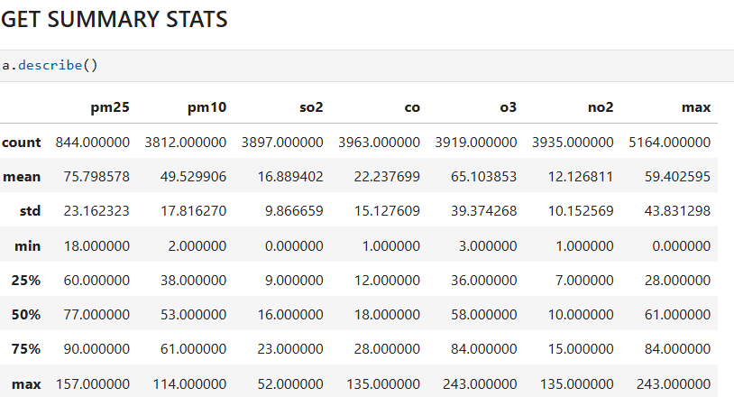
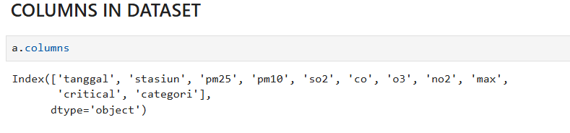
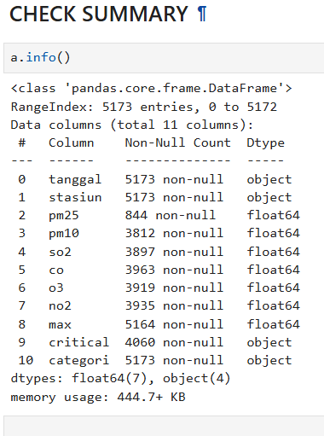
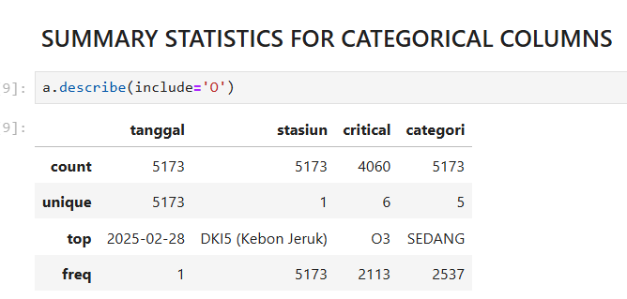
BASIC CHECKS

Slide 7
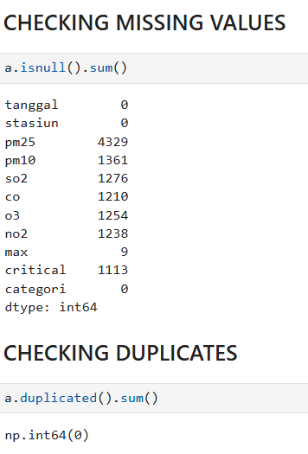
PREPROCESSING TECHNIQUES
8 columns have missing values
No duplicates found
Now we want to perform preprocessing techniques :
Handling missing values
Handling inconsistencies
Date type conversion

Slide 8
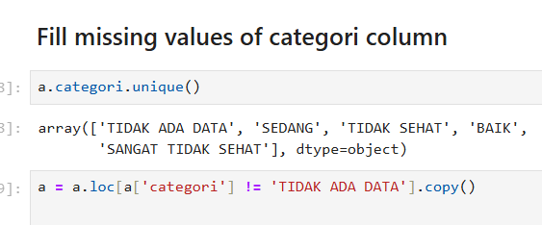
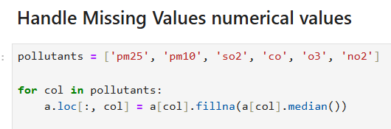
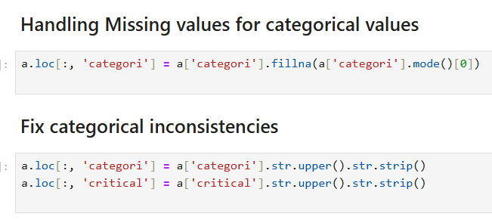
‘TIDAK ADA DATA’ means No date
‘BAIK’ means good
‘SEDANG’ means moderate
‘TIDAK SEHAT ‘ means unhealthy
‘SANGAT TIDAK SEHAT’ means Very unhealthy
TIDAK ADA DATA is removed
Missing numeric value column is handled using median to handle pollutant value
Missing values in categori column is handled using mode to retain most frequent value

Slide 9
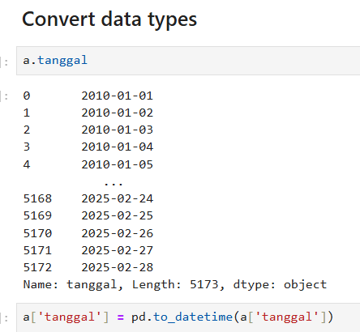
T
Tanggal is the date column
There were no inconsistencies found
To have date in correct format and for time series analysis to_datetime is used

Slide 10
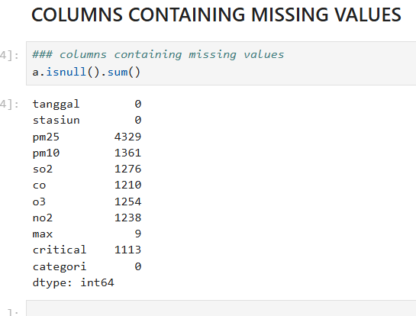
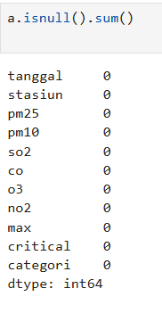
CHECK MISSING VALUES
Before After
The null values are removed and dataset is now ready for analysis

Slide 11
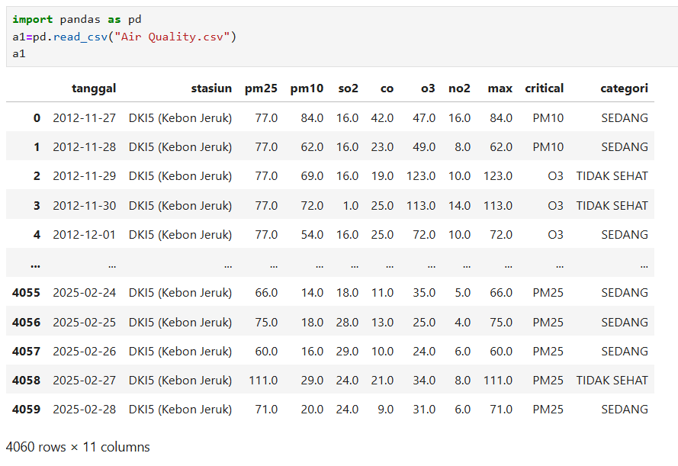
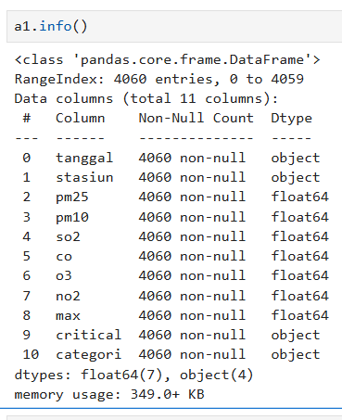
The cleaned date is saved as ‘Air Quality .csv’ and ready to get insights

Slide 12
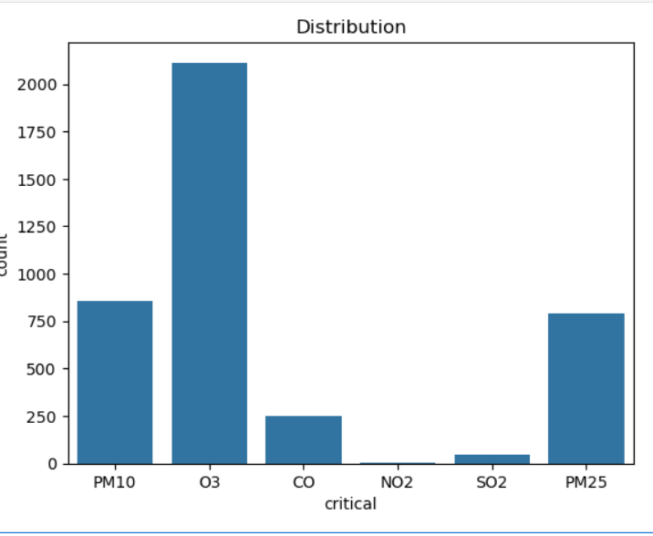
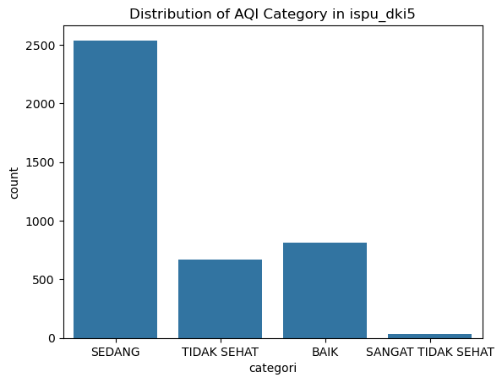
Data analysis through visualizations
Univariate analysis
O3, PM10 ,PM2.5 are the most dominant pollutant
These are contributing to poor air quality
The majority of air quality records fall under Moderate and Unhealthy categories.
This indicates that Jakarta frequently experiences unsafe air quality levels.

Slide 13
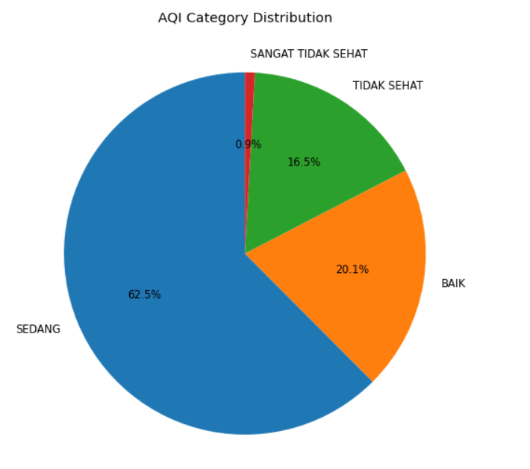
AQI Category Distribution
This is a AQI category analysis
It shows how AQI categories are distributed across dominant pollutants using a count plot
BAIK -> Good
SEDANG-> Moderate
TIDAK SEHAT -> Unhealthy
SANGAT TIDAK SEHAT-> Very Unhealthy

Slide 14
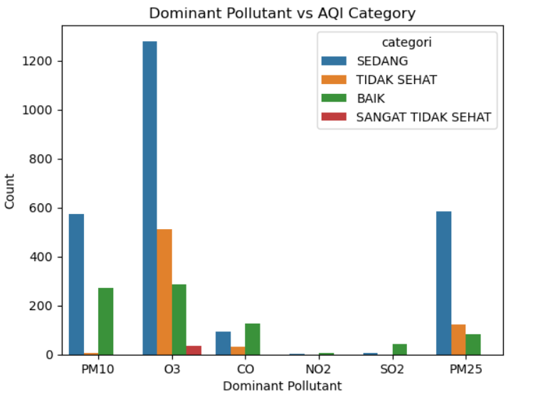
Bivariate analysis
Categorical Vs Categorical
PM2.5, O3,PM10 are dominant pollutants across most AQI categories
Higher AQI categories are strongly associated with particulate matter.
NO2,SO2,CO contribute less to severe air quality conditions.

Slide 15
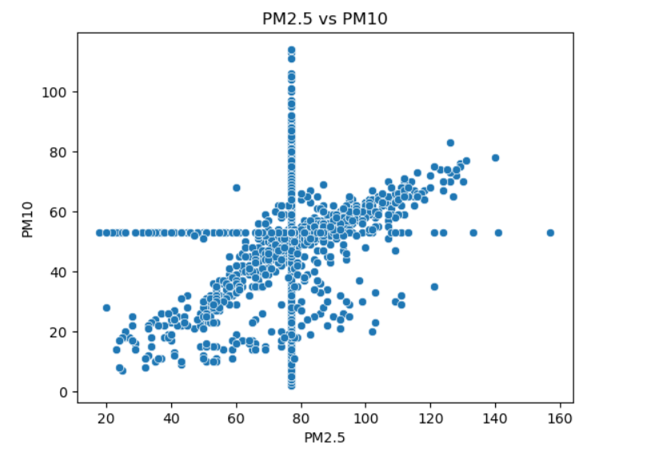
Bivariate analysis
Numerical vs Numerical
PM2.5 and Pm10 show a positive relationship.
Higher PM2.5 values are often associated with higher PM10 values.
This suggests common pollution sources such as traffic and industry.

Slide 16
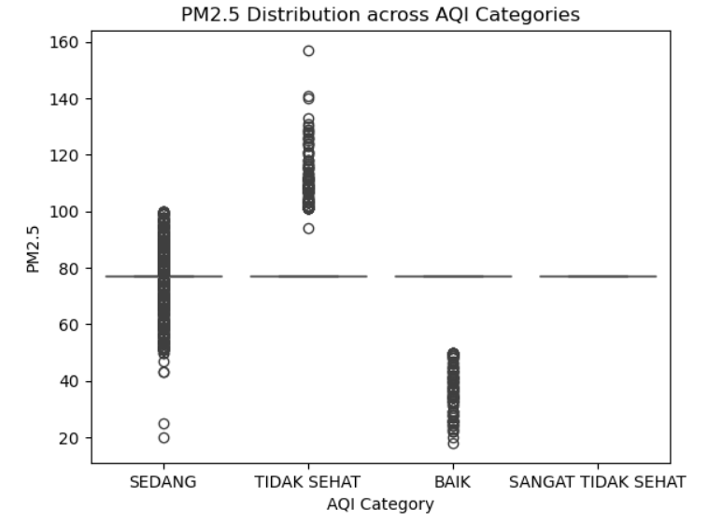
Bivariate analysis
Categorical vs Numerical
This strip plot shows the distribution of PM2.5 values across different AQI categories.
BAIK(good): Low PM2.5 values with minimal variation
SEDANG(moderate): Moderate PM2.5 with wider spread
TIDAK SEHAT(unhealthy): High and variable PM2.5 indicating pollution spikes
SANGAT TIDAK SEHAT(very unhealthy): Highest PM2.5 levels, showing severe air pollution

Slide 17
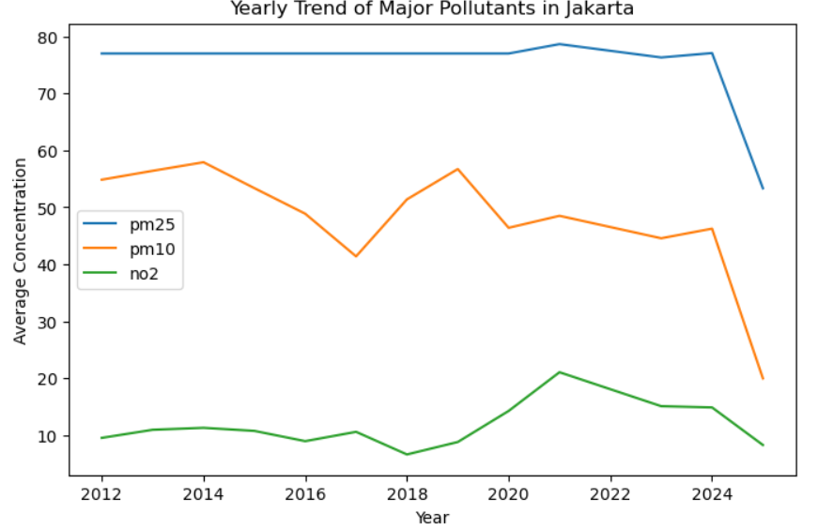
MULTIVARIATE ANALYSIS
PM2.5 remains consistently higher than other pollutants across years.
PM10 and NO2 fluctuate but contribute less compared to PM2.5.
Particulate matter is the dominant air pollution concern in Jakarta.

Slide 18
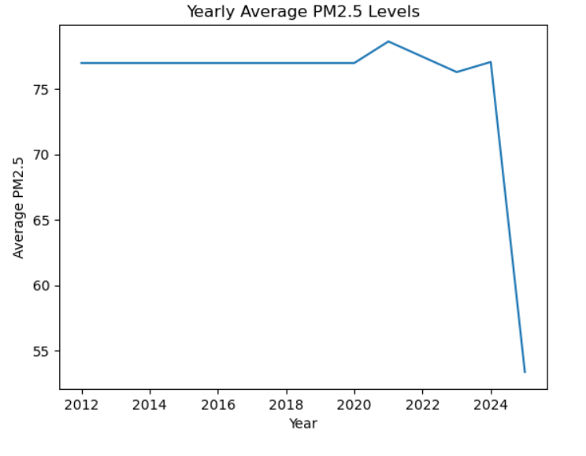
TIME SERIES ANALYSIS
The yearly average PM2.5 level across different years.
PM 2.5 was constant from 2012-2020.
There were fluctuation after 2020
From 2020 -2021 PM 2.5 level is constantly varying
Then it decreased after 2024

Slide 19
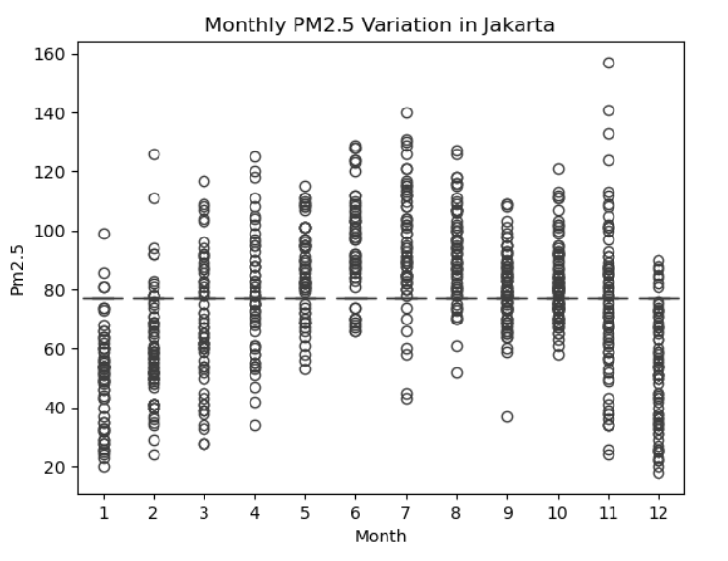
TIME BASED ANALYSIS
Pm2.5 levels vary significantly across different months.
From month 1 pollutant level is increasing .
From month 7 pollutant level is decreasing due to seasonal effect

Slide 20
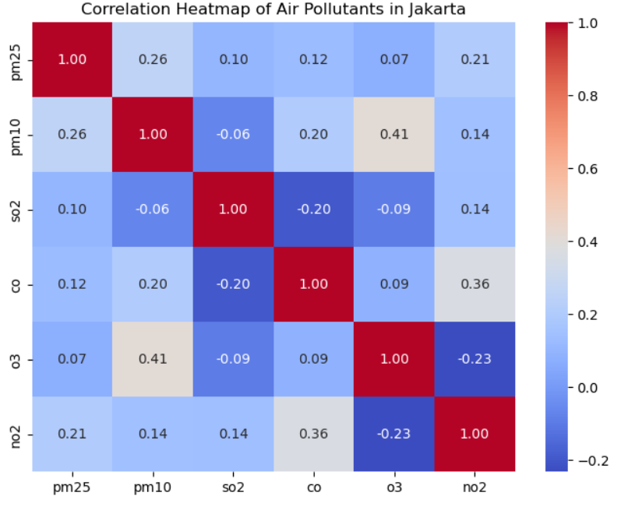
PM2.5 and PM10 show a weak positive correlation, indicating some shared pollution
sources.
NO2 has a weak relationship with PM2.5 and PM10, suggesting different emission patterns.
No strong correlations are observed among pollutants.

Slide 21
Summary
The dataset was cleaned by removing invalid AQI category values
Handled missing data column-wise using median for numerical pollutants
Used mode for categorical variables.
Categorical inconsistencies were fixed by standardizing text format
Date column is converted to datetime, making the dataset time-series ready.
Univariate analysis identified PM2.5 as a dominant pollutant and showed AQI category distribution.
Bivariate analysis revealed how pollutant levels vary across AQI categories and stations.
Multivariate analysis using correlation heatmaps showed weak positive
relationships among pollutants.
Visual EDA highlighted seasonal trends, station-wise variations, and pollution severity patterns..

